Slide 1
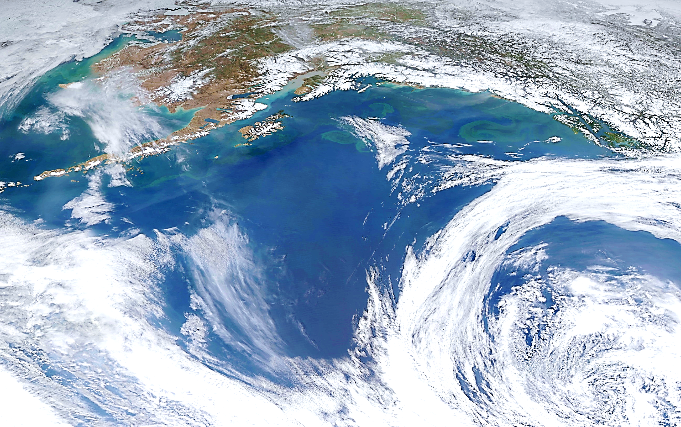
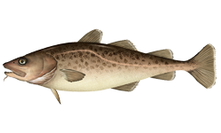
Gulf of Alaska Pacific cod
Steve Barbeaux, Ben Laurel, Mike Litzow, and Ingrid Spies
September 2021

Slide 2
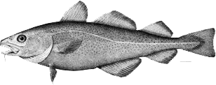
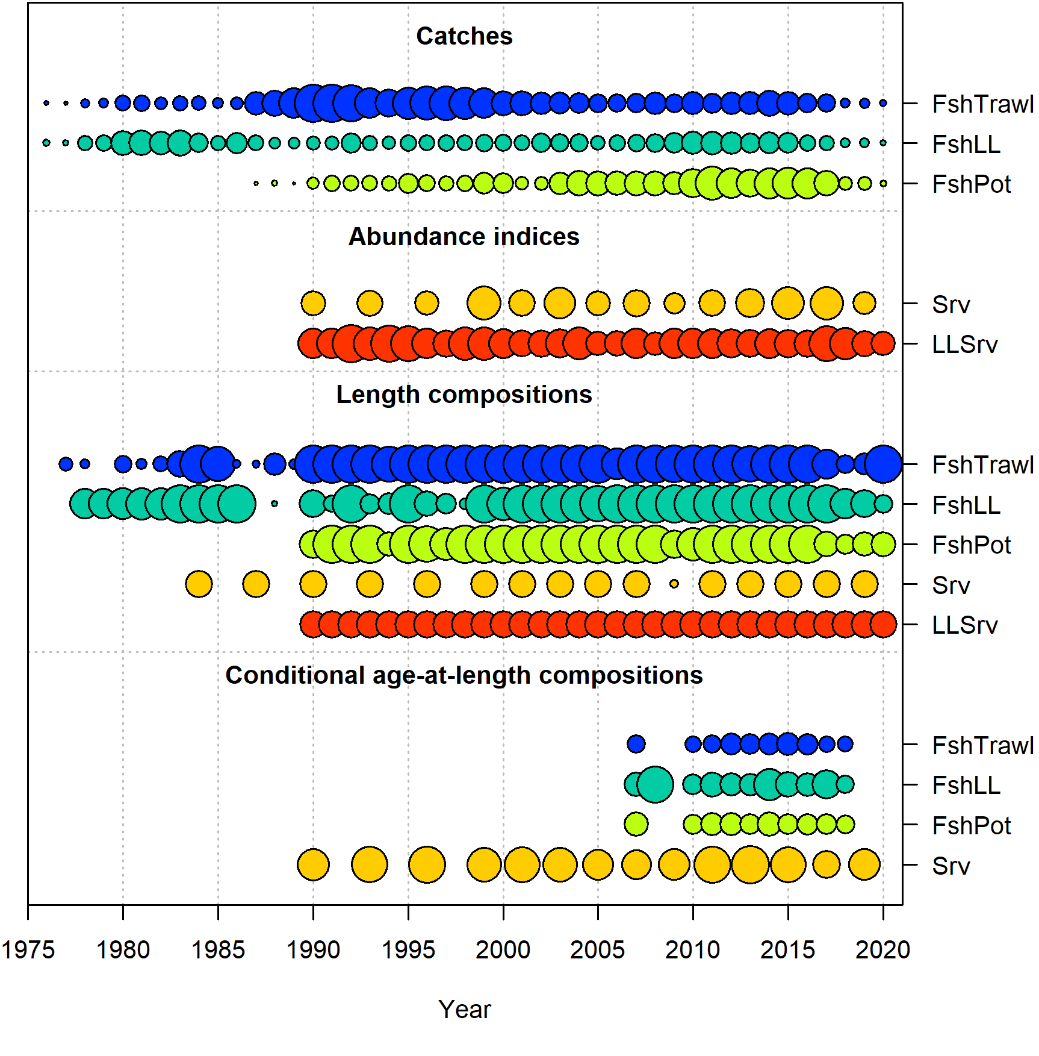
Last year’s model
Fisheries – Longline, Pot, Trawl
Indices – AFSC bottom trawl and AFSC longline surveys
Length composition
All fisheries and indices
Age data
2007+ survey and Fishery conditional age-at-length

Slide 3
Last year’s accepted model features
1-10+ age bins
1-117+cm length bins
Key estimated parameters:
M lognormal prior, mean -0.81, CV 0.41
Survey catchability uninformative prior
M anomaly for the 2014-2016 period
Stock recruitment relationship: Beverton-Holt
σ_{R} = 0.44, steepness = 1.0
Growth
Three-parameter von Bertalanffy growth (informative priors based on 2007-2018 survey size at age data
Selectivity: length-based double normal
Different periods for bottom trawl survey
Longline and trawl
pre-1990 annually varying
blocks for post-1990
Longline survey catchability
scaled to CFSR temperatures for 0-10 cm Pacific cod mean depth

Slide 4
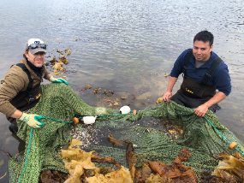
Model configurations
 |  | Environmental links |  |  | Data re-weighting | M-block to 2020
 | Larval index | Growth | M | Recruits | Data re-weighting | M-block to 2020
Base 19.1
21.1a
21.1b
21.1c
21.1d
21.1e
21.1g
21.5a
21.5c

Slide 5
Model configurations
 |  | Environmental links |  |  | Data re-weighting | M-block to 2020
 | Larval index | Growth | M | Recruits | Data re-weighting | M-block to 2020
Base 19.1
21.1a
21.1b
21.1c
21.1d
21.1e
21.1g
21.5a
21.5c

Slide 6
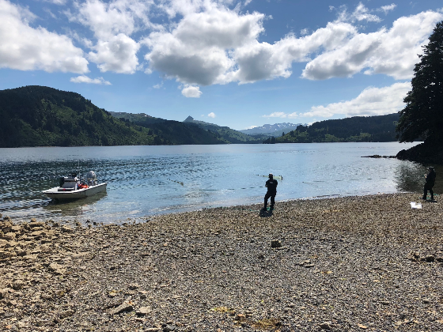
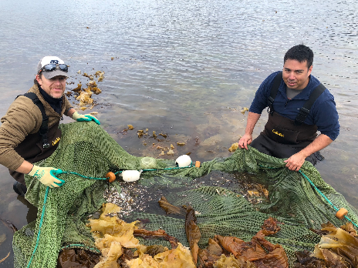
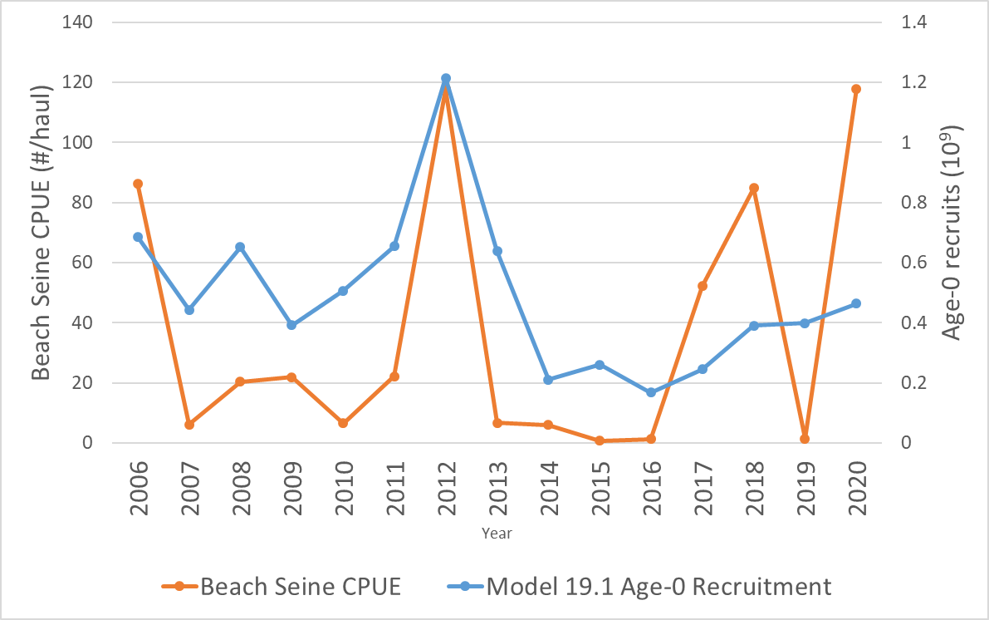
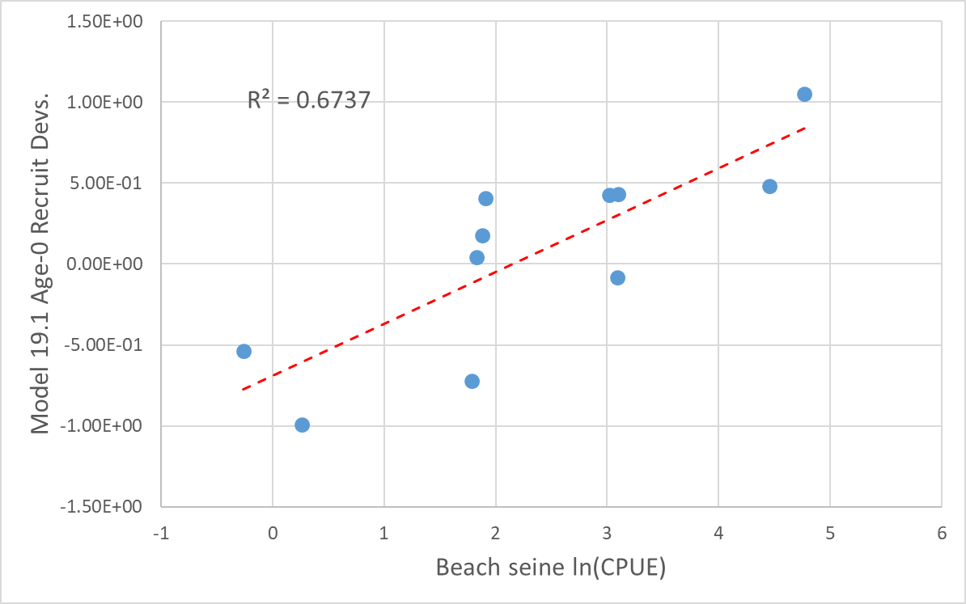
Age-0 Pacific cod beach seine index
Litzow, et al. (In Review) Predicting year class strength for climate-stressed gadid stocks in the Gulf of Alaska. Fisheries Research
2006-2020 Model 19.1
Recruitment vs Beach Seine CPUE
2006-2016 Model 19.1
Recruitment Devs. vs ln(Beach Seine CPUE)

Slide 7
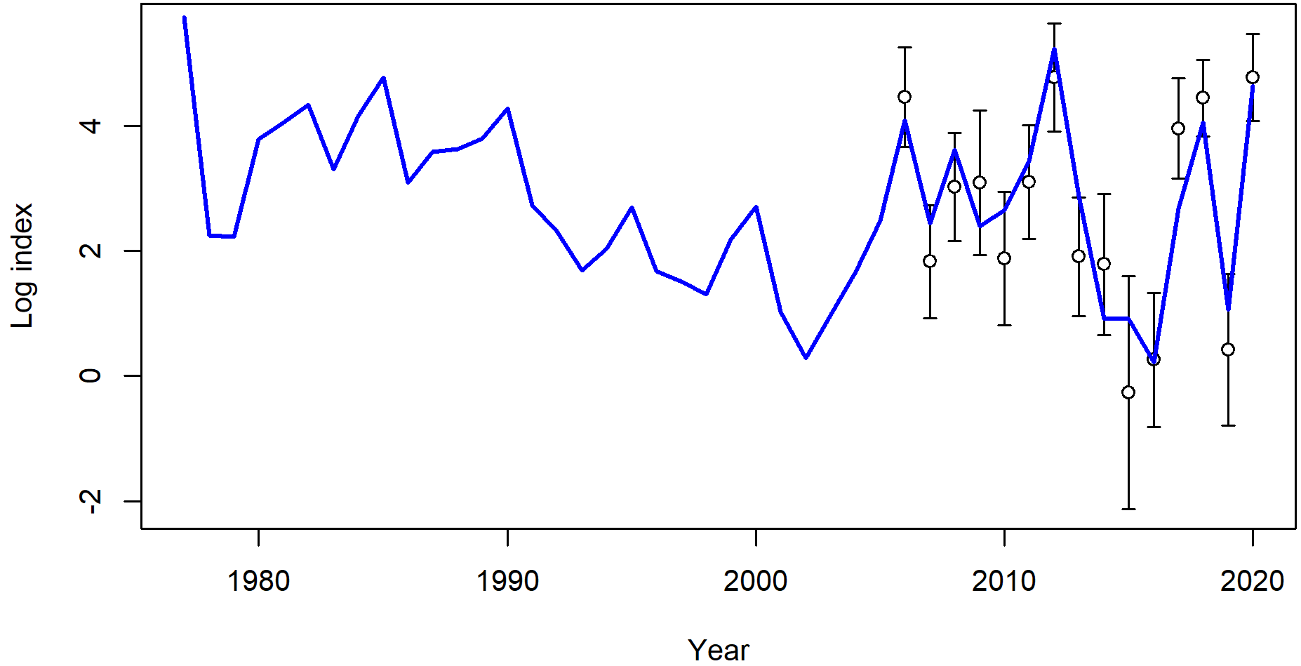
Model 21.1a vs. Model 19.1
Addition of Age-0 beach seine index
Good fit to beach seine index

Slide 8
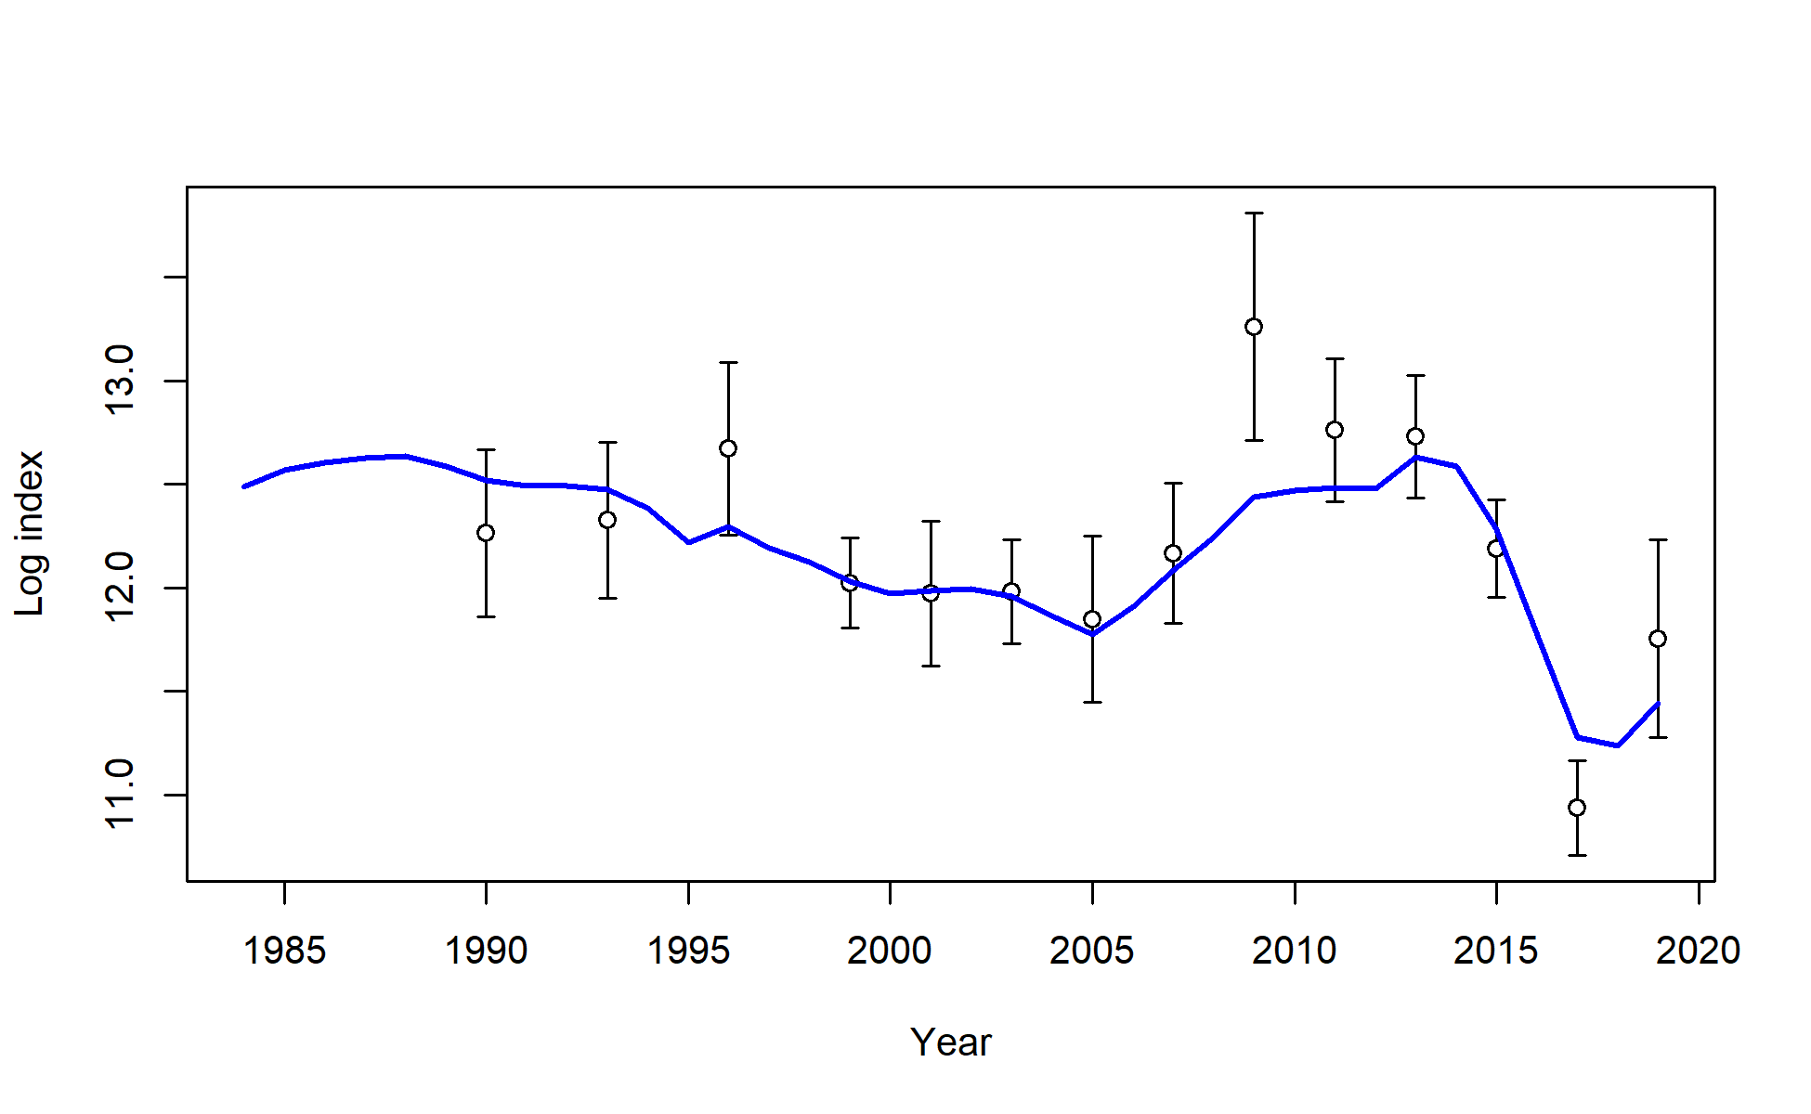
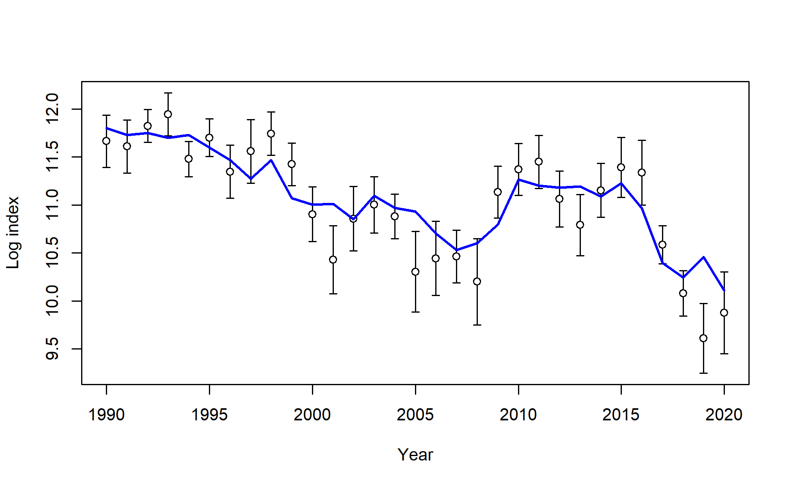
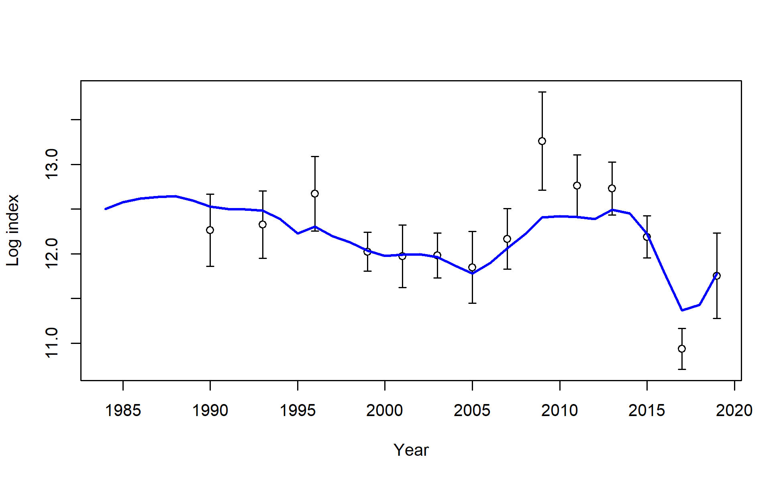

Model 21.1a vs. Model 19.1
Addition of Age-0 beach seine index
Good fit to beach seine index
Poorer fit to all other survey indices
Bottom Trawl Survey Index
Longline Survey Index
Model19.1
Model21.1a

Slide 9
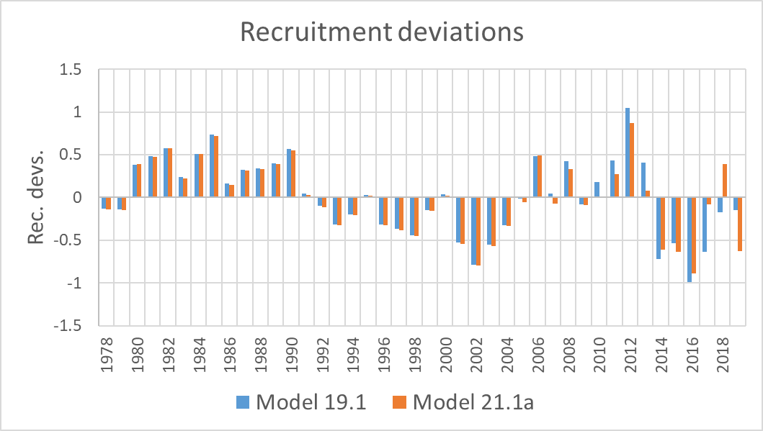
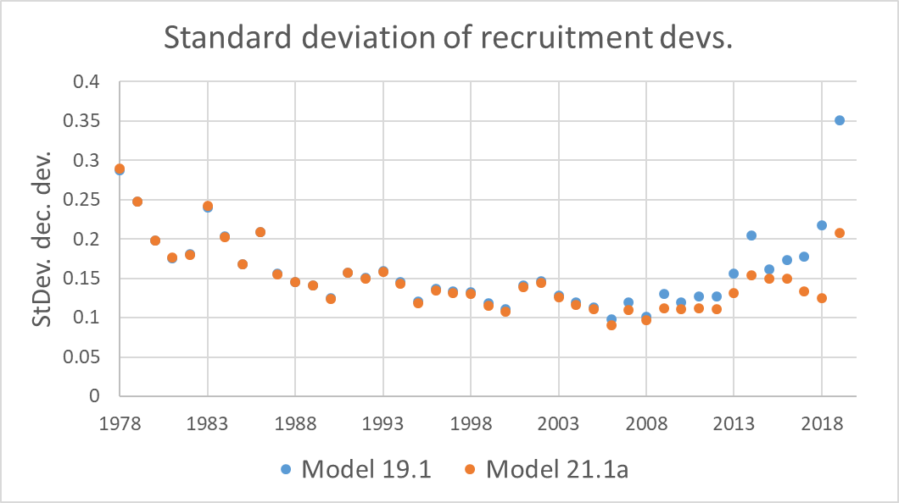
Model 21.1a vs. Model 19.1
Addition of Age-0 beach seine index
Good fit to beach seine index
Poorer fit to all other survey indices
Reduced rec. devs. and variance of rec. devs.
Reduced variance on reference points
Reduction in heatwave block M from 0.82 to 0.75
Mixed results for composition fits
Retrospective Rho’s and RMSE remain close to the same

Slide 10
Model configurations
 |  | Environmental links |  |  | Data re-weighting | M-block to 2020
 | Larval index | Growth | M | Recruits | Data re-weighting | M-block to 2020
Base 19.1
21.1a
21.1b
21.1c
21.1d
21.1e
21.1g
21.5a
21.5c

Slide 11

Environmental links
Growth
June CFSR temps for 0-20 cm cod
Larval growth index based on June CFSR temps
Mortality
Annual heatwave index
Recruitment
Spawning heatwave index

Slide 12
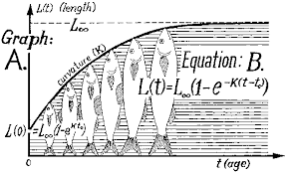
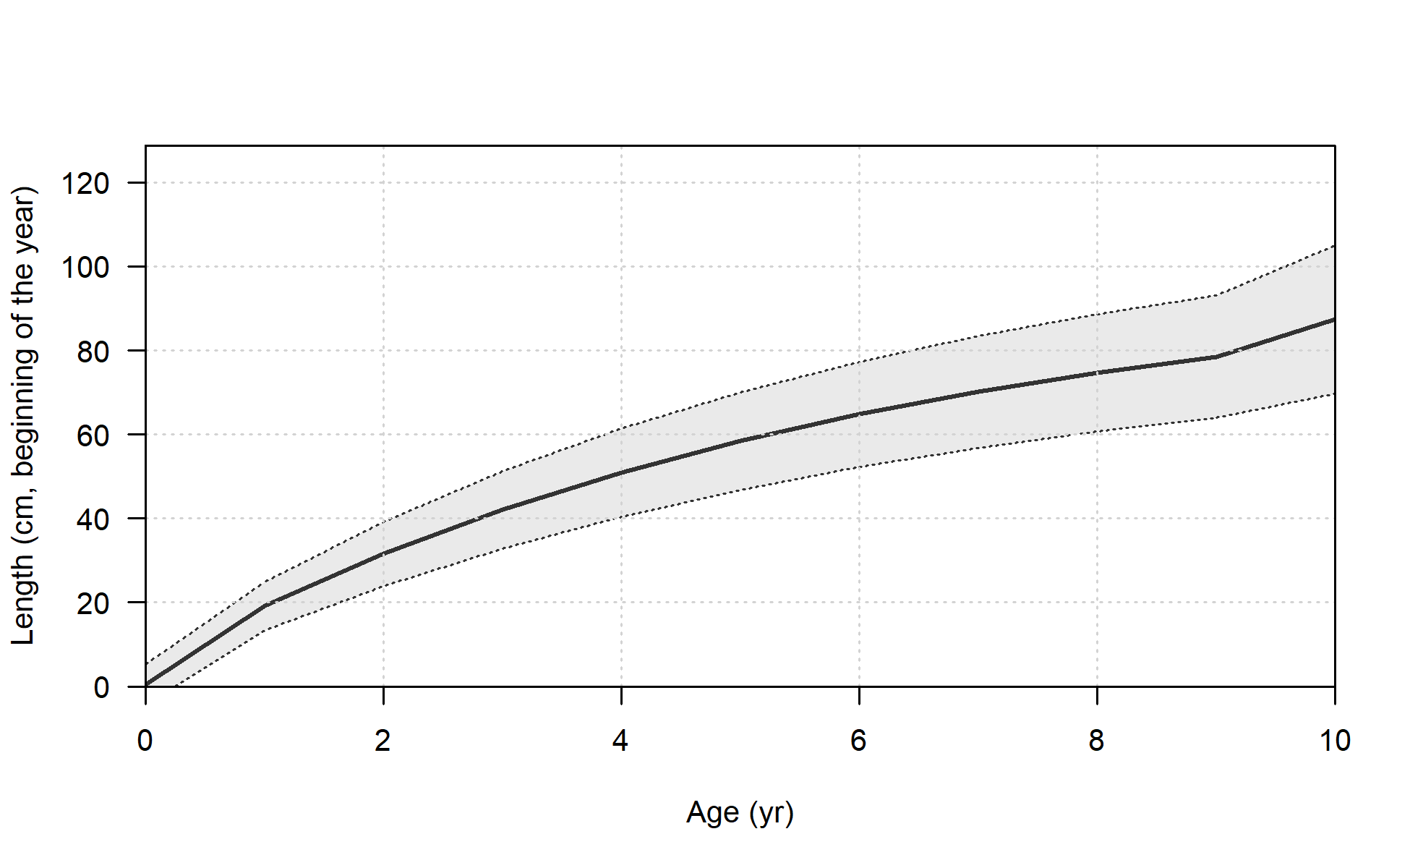
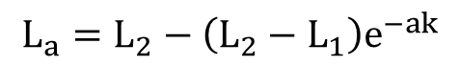
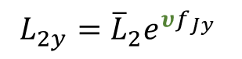
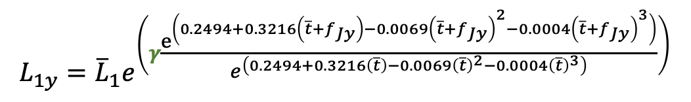
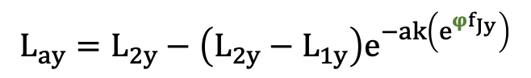
Growth
Model 19.1 standard Stock Synthesis von Bertalanfy
June temp. anomaly-linked von Bertalanfy with Laurel et al. (2015) larval growth index
$$L_{a}={L_{2}−\left(L_{2}−L_{1}\right)e}^{−ak}$$
$$L_{ay}={L_{2y}−\left(L_{2y}−L_{1y}\right)e}^{−ak\left(e^{{φf}_{Jy}}\right)}$$
$$L_{1y}={\overline{L}}_{1}e^{\left(γ\frac{e^{\left(0.2494+0.3216\left(\overline{t}+f_{Jy}\right)−0.0069{\left(\overline{t}+f_{Jy}\right)}^{2}−0.0004{\left(\overline{t}+f_{Jy}\right)}^{3}\right)}}{e^{\left(0.2494+0.3216\left(\overline{t}\right)−0.0069{\left(\overline{t}\right)}^{2}−0.0004{\left(\overline{t}\right)}^{3}\right)}}\right)}$$
$$L_{2y}={\overline{L}}_{2}e^{υf_{Jy}}$$
f_{Jy} = June temperature anomaly; $\overline{t}$ = 1982-2012 mean temp.
Notes:
Will need to explain equation.

Slide 13
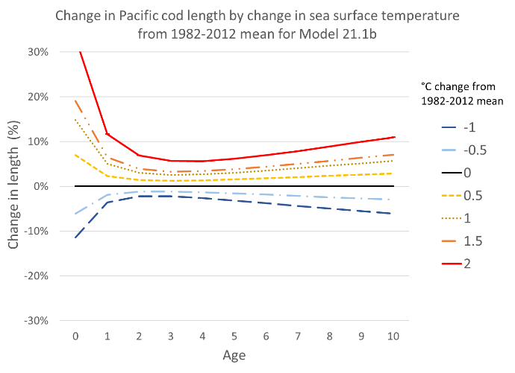
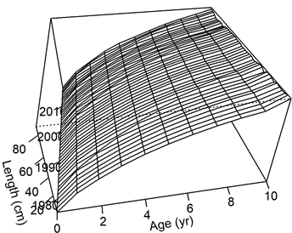
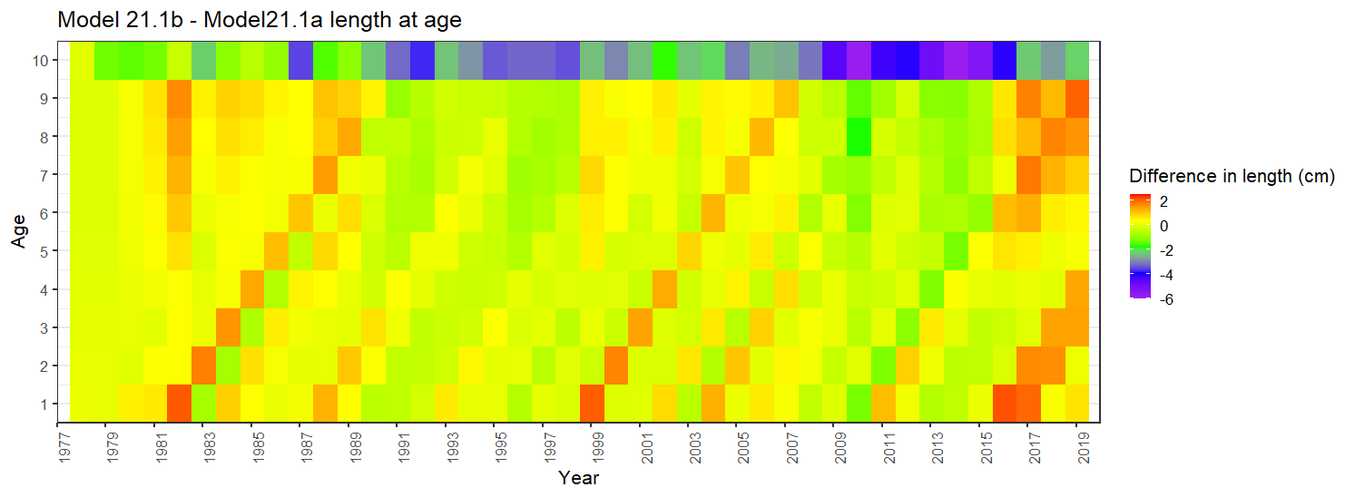

Slide 14

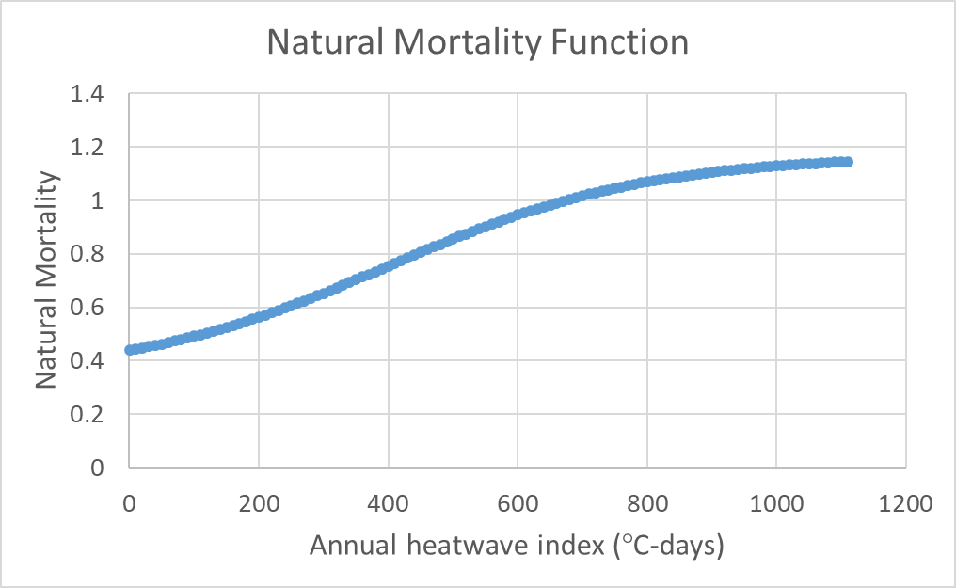
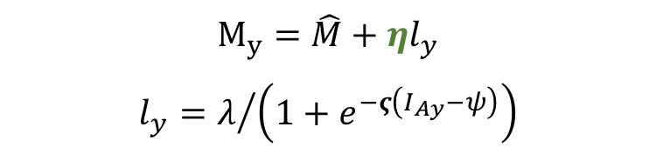
Natural Mortality
Model 19.1, 21.1a, 21.1b,and 21.1d: separate block for 2014-2016
Model 21.1c, 21.1e, and 21.1g: annual heatwave linked natural mortality with asymptote
Logistic function fit iteratively
λ = 0.65
ς = 0.05
ψ = 400
$$M_{y}=\hat{M}+ηl_{y}$$
$$l_{y}=λ/{\left(1+e^{−ς\left(I_{Ay}−ψ\right)}\right)}$$
Logistic function for asymptotic M

Slide 15
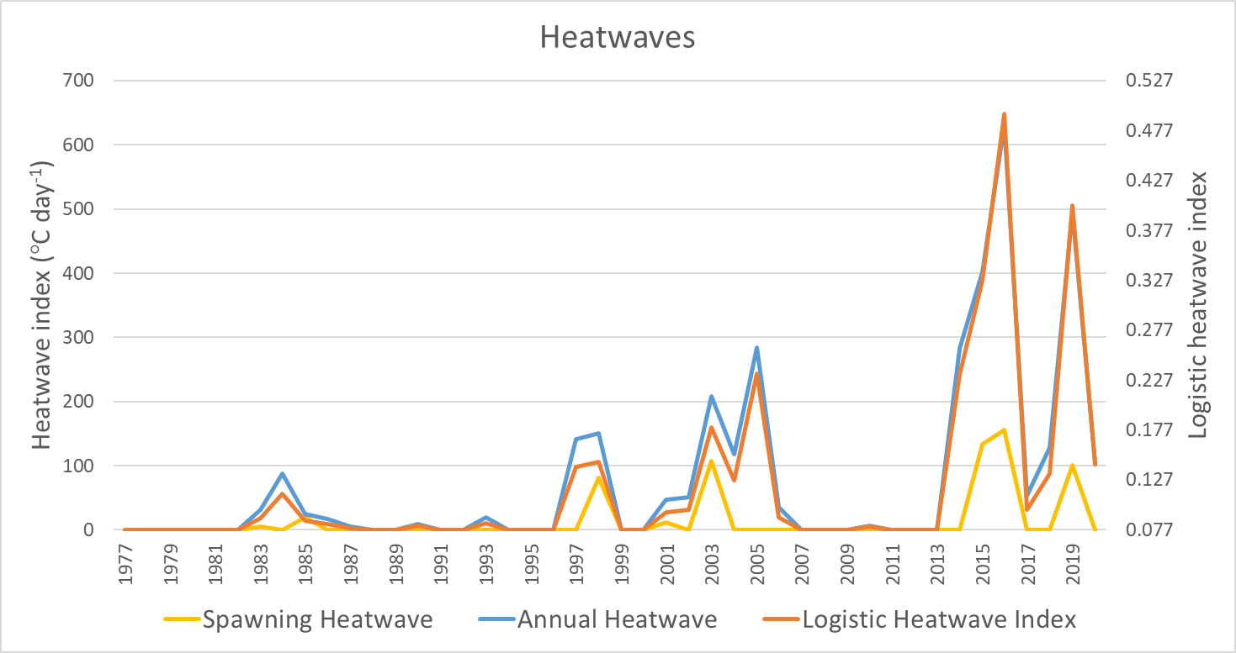
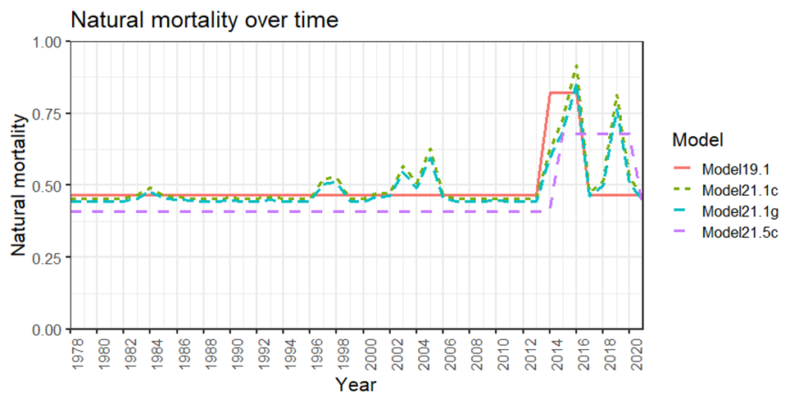
Natural Mortality
Model 21.5 series
Iteratively fit annual natural mortality
Best fit model with lowest objective value had a separate block for 2015-2020

Slide 16
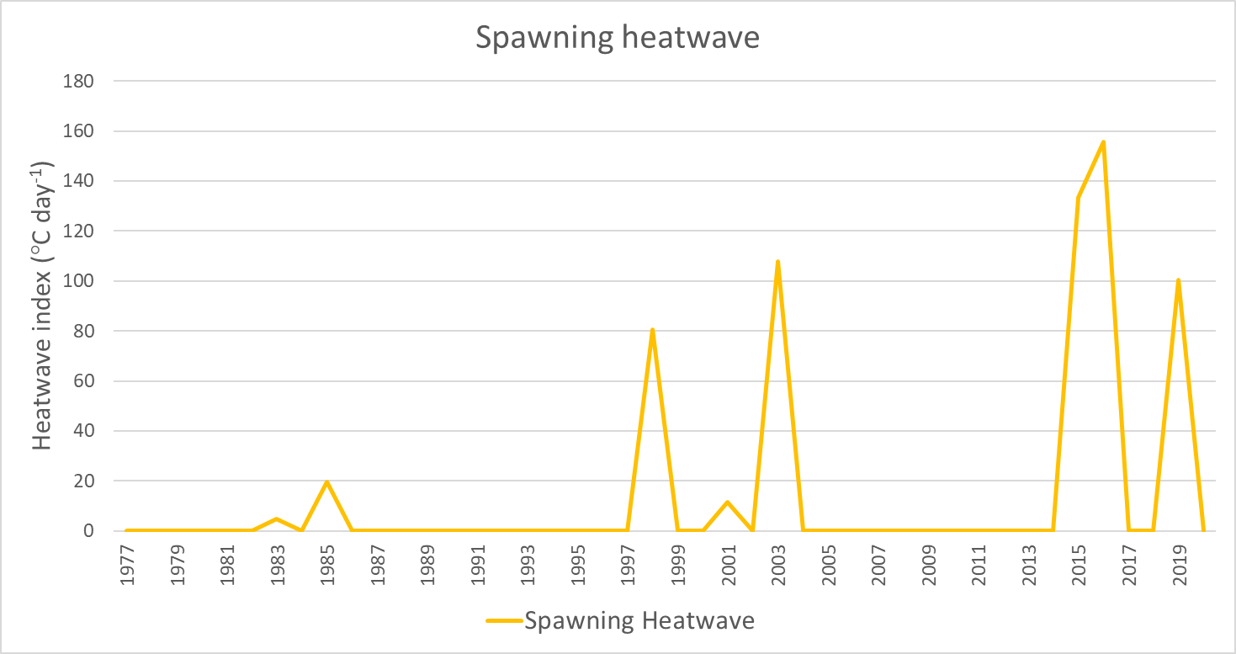
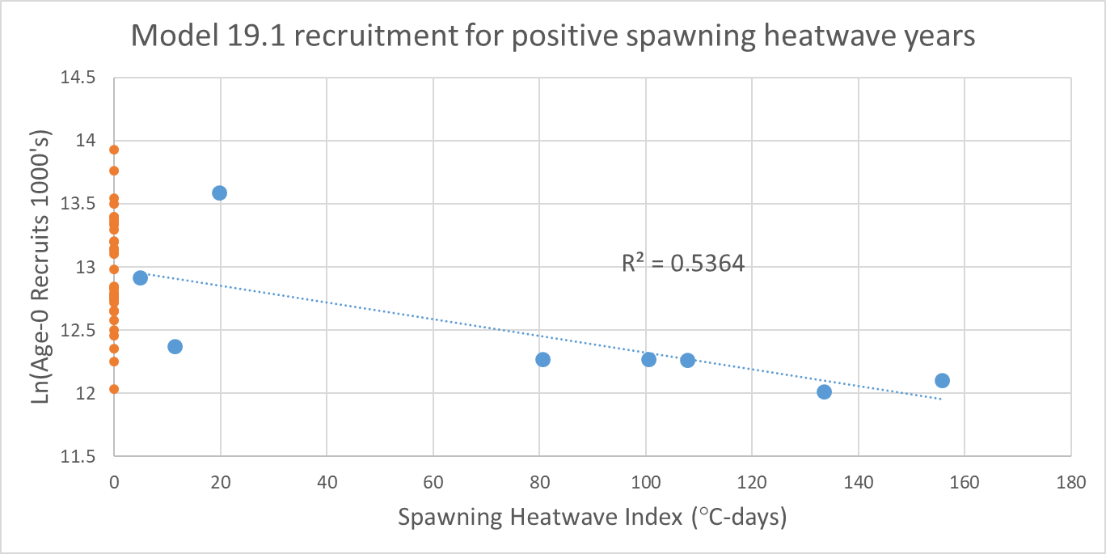
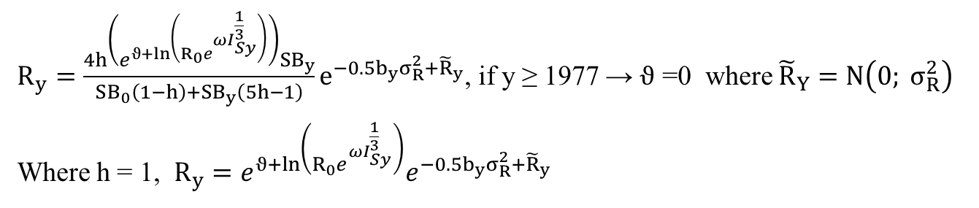
Recruitment
Standard Tier 3 recruitment
Spawning heatwave-linked recruitment
$R_{y}=\left(R_{0}e^{ϑ}\right)e^{−0.5b_{y}σ_{R}^{2}+{\tilde{R}}_{y}}$ , if y ≥ 1977 → $ϑ$ = 0, where ${\tilde{R}}_{y}=N\left(0; σ_{R}^{2}\right)$
$R_{y}=\frac{4h\left(e^{ϑ+ln\left(R_{0}e^{ωI_{Sy}^{\frac{1}{3}}}\right)}⁡\right){SB}_{y}}{{SB}_{0}\left(1−h\right)+{SB}_{y}\left(5h−1\right)}e^{−0.5b_{y}σ_{R}^{2}+{\tilde{R}}_{y}}$, if y ≥ 1977 → $ϑ$ =0 where ${\tilde{R}}_{Y}=N\left(0; σ_{R}^{2}\right)$
Where h = 1, $R_{y}=e^{ϑ+ln\left(R_{0}e^{ωI_{Sy}^{\frac{1}{3}}}\right)}e^{−0.5b_{y}σ_{R}^{2}+{\tilde{R}}_{y}}$

Slide 17
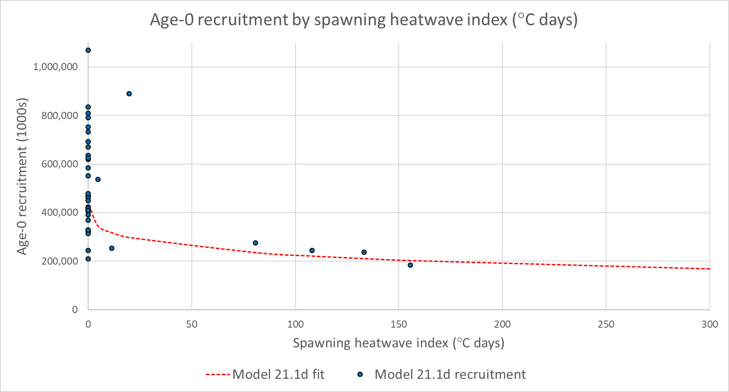
Model 21.1d recruitment
2016

Slide 18
Model configurations
 |  | Ecosystem Links |  |  | Data re-weighting | M-block to 2020
 | Larval index | Growth | M | Recruits | Data re-weighting | M-block to 2020
Base 19.1
21.1a
21.1b
21.1c
21.1d
21.1e
21.1g
21.5a
21.5c

Slide 19

Model tuning
Indices
Standard Error + adjustment tuned to RMSE
Age and length sample size
Francis 1A.18 method as implemented in R4SS
Reduced sample size for all composition data
Tuning results
All data components were given higher variance/lower sample size
Increased emphasis on model structure and priors
More weight on indices with slight overfitting based on RMSSR < 1.0
Additional tuning of indices necessary
High survey catchability ( > 1.4)

Slide 20
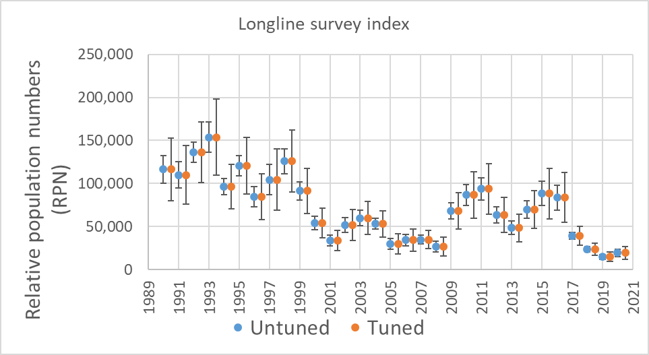
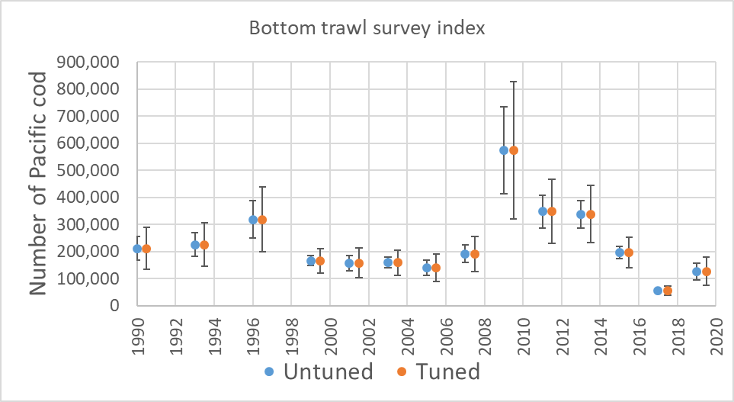
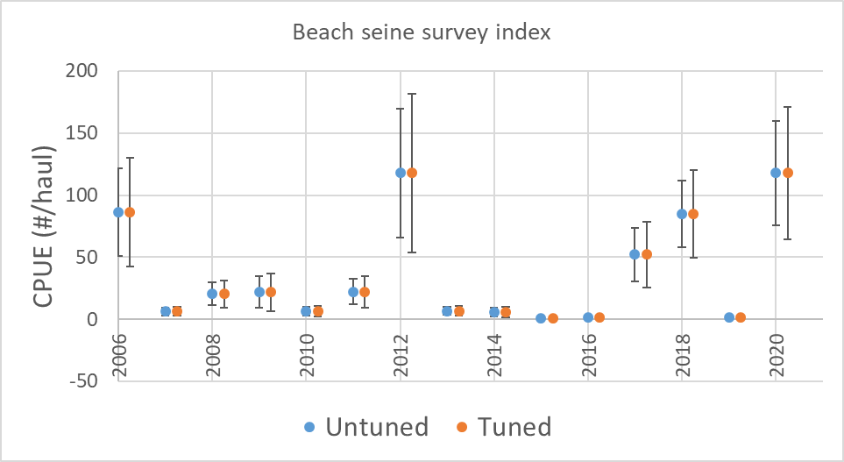
Model tuning
Component |  | Tuning | Model 21.1g | Model 21.5c
Index | Beach seine survey | add_to_survey_CV | 0.100 | 0.100
 | Bottom trawl survey | add_to_survey_CV | 0.162 | 0.162
 | Longline survey | add_to_survey_CV | 0.171 | 0.171
Length | Trawl fishery | mult_by_lencomp_N | 0.256 | 0.257
 | Longline fishery | mult_by_lencomp_N | 0.417 | 0.423
 | Pot fishery | mult_by_lencomp_N | 0.156 | 0.152
 | Bottom trawl survey | mult_by_lencomp_N | 0.432 | 0.420
 | Longline survey | mult_by_lencomp_N | 0.403 | 0.412
Age | Trawl fishery | mult_by_agecomp_N | 0.511 | 0.532
 | Longline fishery | mult_by_agecomp_N | 0.572 | 0.577
 | Pot Fishery | mult_by_agecomp_N | 0.346 | 0.358
 | Bottom trawl survey | mult_by_agecomp_N | 0.196 | 0.192

Slide 21

Model evaluation
 |  |  |  |  |  |  | Retrospective analysis (SSB)
 | Attributes | # Parameters | -Log likelihood | AIC | -Marginal log likelihood | Marginal AIC | ρ | Woodshole ρ | RMSE
Model 19.1 |  | 201 | 3,190.0 | 6,782.0 | 3,356.6 | 7,115.3 | 0.081 | 0.085 | 0.152
Model 21.1a |  | 202 | 3,210.5 | 6,825.1 | 3,368.7 | 7,139.3 | 0.087 | 0.071 | 0.162
Model 21.1b | G | 204 | 3,202.8 | 6,813.7 | 3,372.1 | 7,152.3 | 0.129 | 0.080 | 0.178
Model 21.1c | Mh | 201 | 3,194.1 | 6,790.2 | 3,352.2 | 7,106.4 | 0.101 | 0.063 | 0.159
Model 21.1d | R | 203 | 3,205.1 | 6,816.1 | 3,368.7 | 7,141.5 | 0.086 | 0.067 | 0.145
Model 21.1e | G, R, Mh | 205 | 3,182.1 | 6,774.2 | 3,356.3 | 7,122.6 | 0.164 | 0.072 | 0.183
Model 21.1g | G, R, Mh, T | 205 | 2,039.6 | 4,489.2 | 2,149.1 | 4,708.2 | 0.164 | 0.120 | 0.198
Model 21.5a | G,R,M20 | 205 | 3,168.7 | 6,747.4 | 3,343.6 | 7,097.2 | 0.132 | 0.121 | 0.223
Model 21.5c | G,R,T | 205 | 2,036.4 | 4,482.9 | 2,149.8 | 4,709.5 | -0.047 | -0.015 | 0.078
Can’t compare full objective values or AIC across all models with addition of new data and reweighting
Of the comparable models Model 21.5a had the best overall fit by improving fit to longline survey data at a cost to other model data and possibly unreasonably high catchability (Q=1.36)

Slide 22

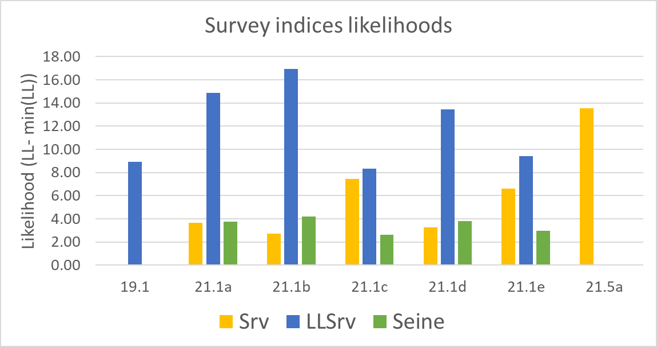
Likelihood components
*
*
*

Slide 23
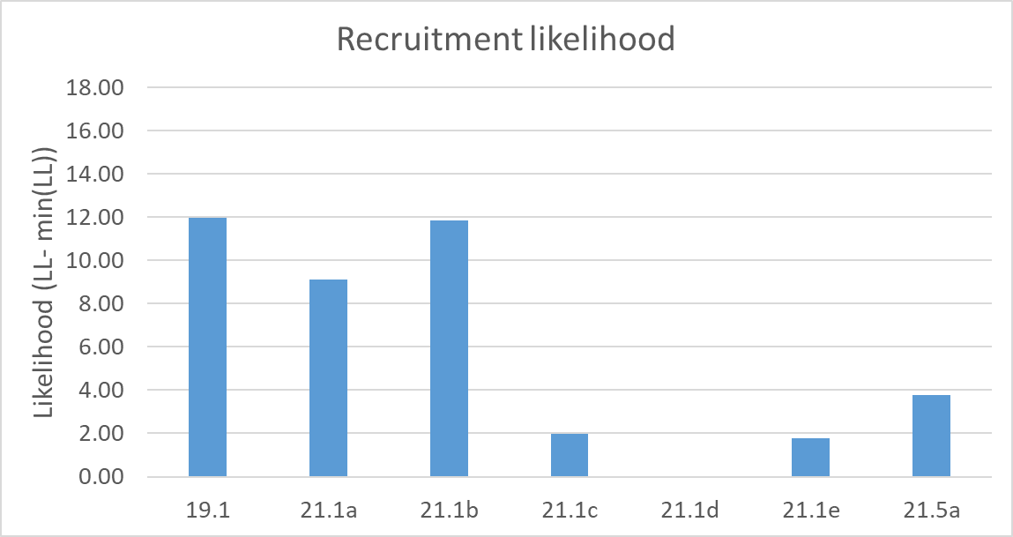
Likelihood components
Recruitment likelihood improved for beach seine index models
Temperature dependent growth increased recruitment devs
*

Slide 24
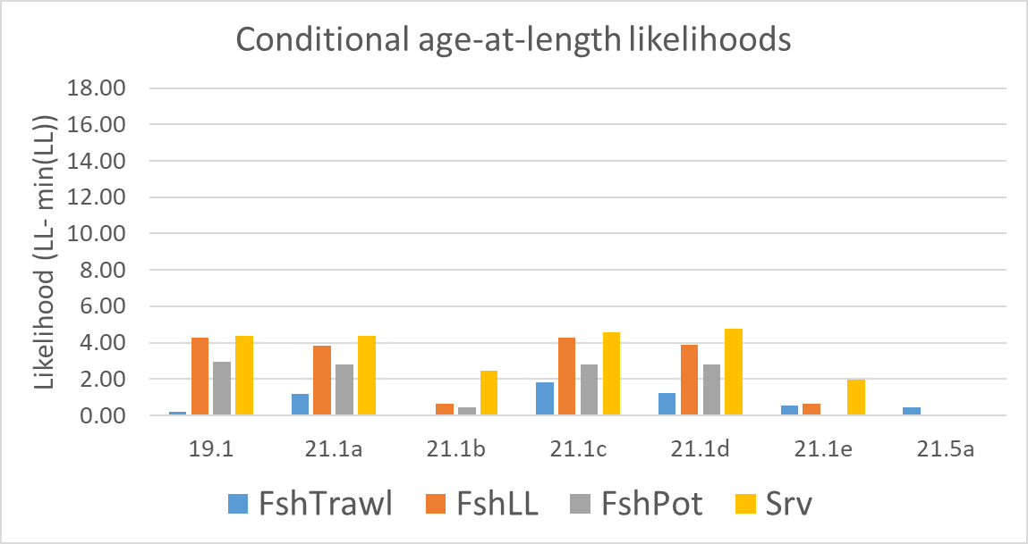
Likelihood components
*
*
*
*

Slide 25
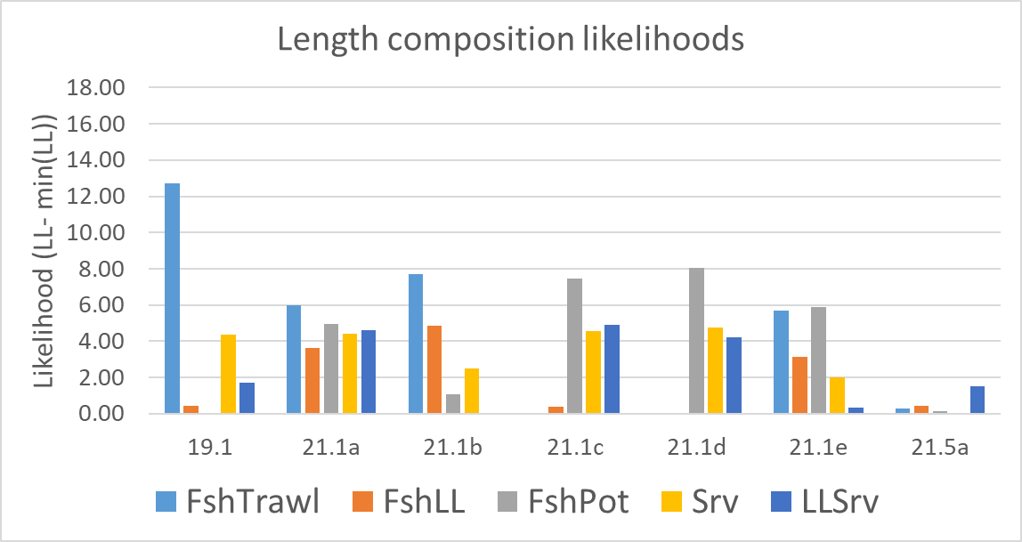
Likelihood components
*
*
*
*
*

Slide 26
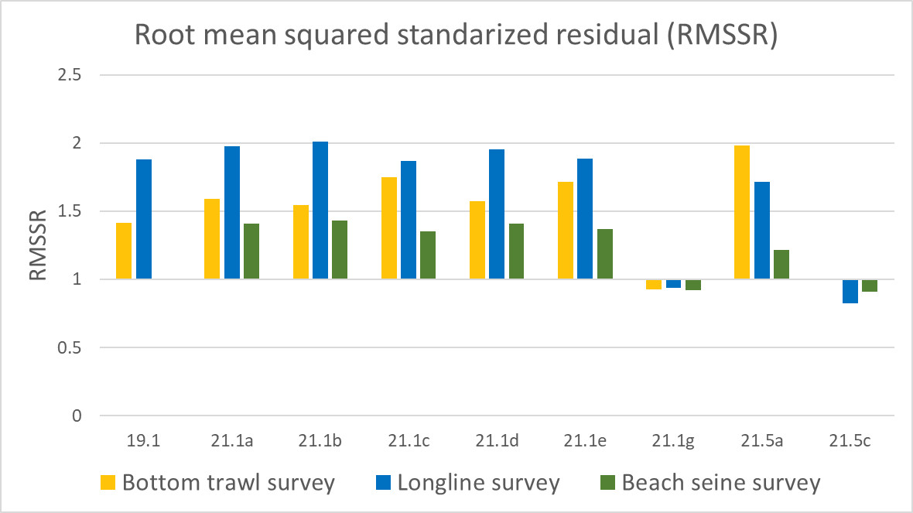
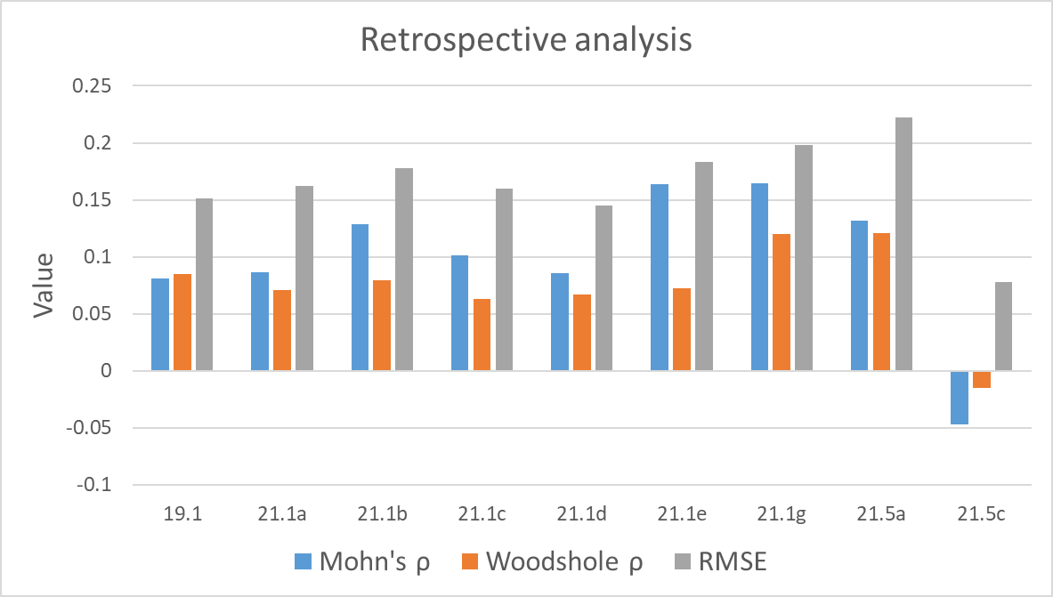
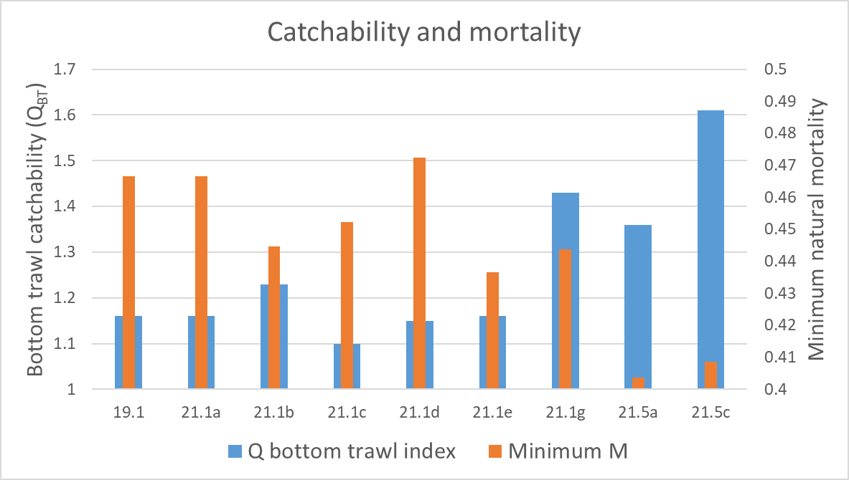
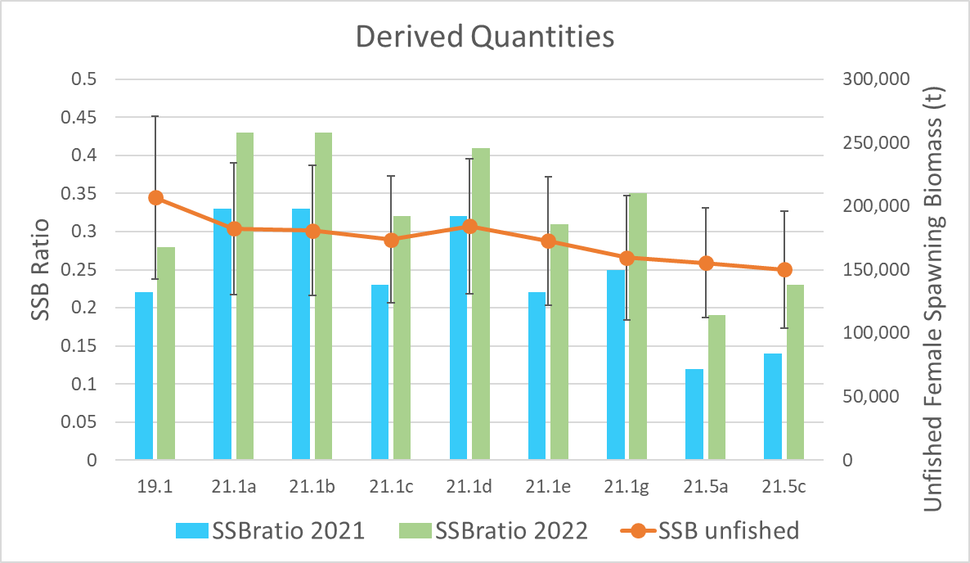
Model evaluation
=Tuned models

Slide 27
Model evaluation
=Tuned models
Increased RMSSR for longline and bottom trawl survey with the addition of the beach seine survey index
RMSSR > 1 indicates possible underfitting, < 1 overfitting.

Slide 28
Model evaluation
=Tuned models
Positive bias in SSB for all models except 21.5c
Mohn’s Rho within acceptable bounds for all models

Slide 29
Model evaluation
=Tuned models
Very high survey catchability in 21.5 series and tuned models
Unreasonable?
Minimum M between 0.40 and 0.47 for all models

Slide 30
Model evaluation
=Tuned models
Unfished spawning biomass similar for all 21.1 series models
Lower uncertainty for reference points in models with beach seine index
All models agree with increasing spawning biomass in 2022

Slide 31
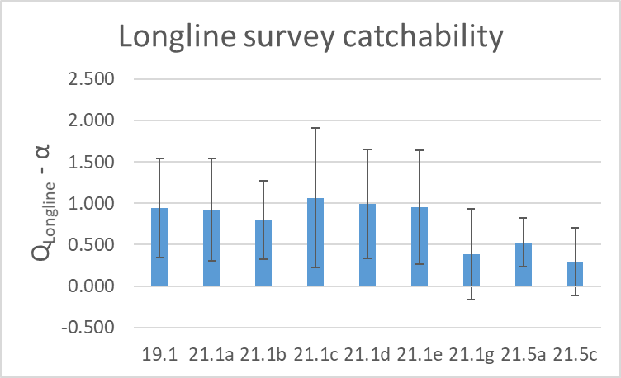
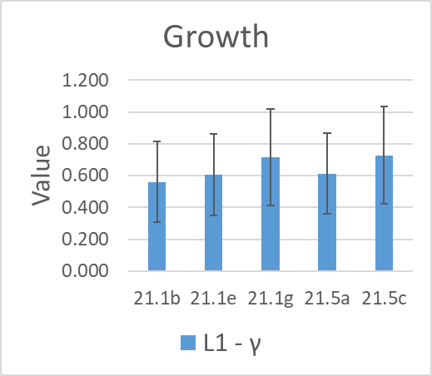
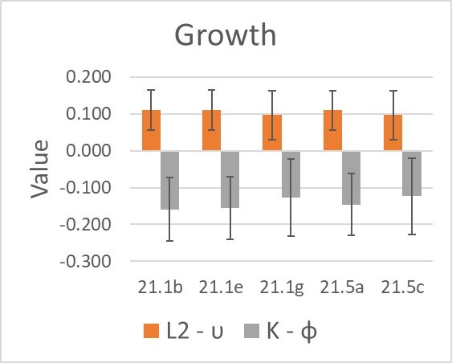
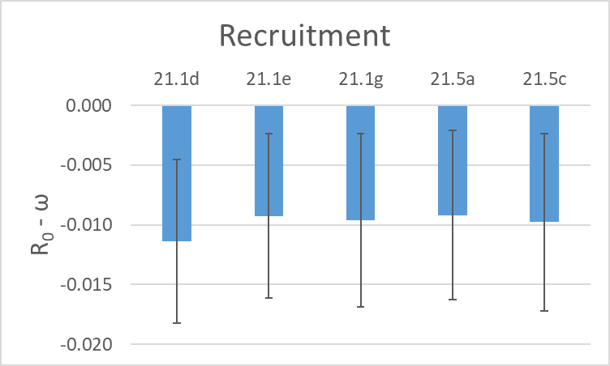
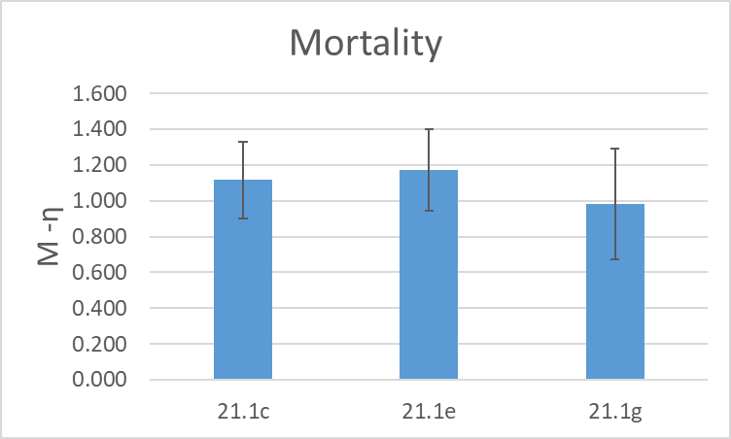
Model evaluation Environmental-link parameters
=Tuned models

Slide 32
Model evaluation Environmental-link parameters
=Tuned models
Re-weighting resulted in less influence of temperature on longline survey catchability

Slide 33
Model evaluation Environmental-link parameters
=Tuned models
Consistent growth link parameters over all models.

Slide 34
Model evaluation Environmental-link parameters
=Tuned models
Recruitment heatwave link parameter
Somewhat uncertain, but stable
Mortality heatwave link parameter
Well fit in all three models resulting in similar maximum M

Slide 35
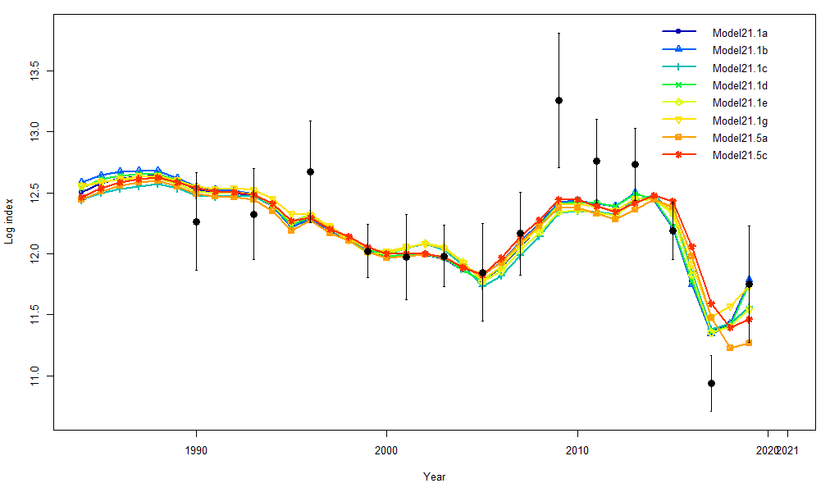
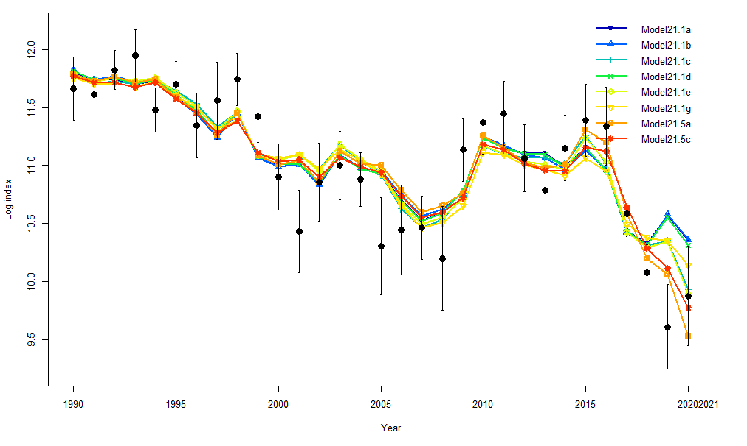

Models 21.1 and 21.5 series fits to indices
Poor fit in all models to bottom trawl survey index for 2009-13 and 2017
Largest differences in fit were to the 2017-2020 adult survey indices
High agreement in all models to the larval beach seine survey index fit.
Bottom trawl survey
Longline survey
Beach seine survey

Slide 36


Model 21.1 and 21.5 series results

Slide 37


Model 21.1 and 21.5 series results

Slide 38
Summary
The age-0 beach seine index was consistent with previous estimates
Pro: Including reduced uncertainty in recent recruitment estimates
Con: Degraded fit to other indices
Addition of temperature impacts on key parameters was reasonable
Relative to fitting available data
Data weighting impacted survey catchability estimates
Further work needed to investigate why high Qs in tuned models
Small changes in environmental linkages or weighting led to large changes reference points

Slide 39

New Data to be added for November
2021 Observer fishery length composition data
2019-2020 observer fishery age data
2021 ADF&G port sampling fish length composition
2021 Bottom trawl survey and length composition
2021 Longline survey index and length composition
2021 Beach seine survey age-0 index

Slide 40

Proposed models for November
Model 19.1
Base model
Model 21.1e
Growth, mortality, and recruitment enviro-linked
Model 21.1g
Growth, mortality, and recruitment enviro-linked
Retuned (RMSSR to 1.0, Francis 1A.18 for composition/Dirichlet)
Model 21.5c
Growth and recruitment enviro-linked
Mortality block iteratively re-explored with new data
Retuned (RMSSR to 1.0, Francis 1A.18 for composition/Dirichlet)
Model 21.6 – (Tuned Model21.1a)
Base model
Beach seine index
Retuned (RMSSR to 1.0, Francis 1A.18 for composition/Dirichlet)

Slide 41
November model evaluation?
What specifically does the Team want to see for model selection?
Model fit criteria (likelihood, RMSSR, etc…)
Retrospective analysis
Key parameter estimates and variance
Leave-one-out analyses (variability in key parameters)?

Slide 42

2021 Western Gulf Pacific cod tagging study
Collaboration with Aleutians East Borough
P.I.s:
Susanne McDermott (NOAA)
Wayne Palsson (NOAA)
Steve Barbeaux (NOAA)
Charlotte Levy (Aleutians East Borough)
PACT (Pacific cod tagging team):
Rebecca Haehn (NOAA)
Liz Dawson (NOAA)
Kim Rand (Lynker Technologies)
Julie Nielsen (Kingfisher Marine Research)
Funding:
National Cooperative Research Program (NCRP)
25 satellite tags
957 conventional tags
Shumagin Is. release area
Notes:
Tagging study to determine where cod go from winter spawning grounds in western gulf of Alaska. Assess connectivity between GOA and Bering Sea management areas.
Collaboration with the Aleutians East Borough, funding from the cooperative research program. Worked with local fishers to capture and tag cod.
In March 2021, we released 25 satellite tags and 957 conventional tags in the Shumagin Island area. Map shows recovery (pop-up or vessel recapture) locations through August. During the June – August period, 9 of 16 recoveries were in the Bering Sea. More pop-ups to come (some programmed for 180 and 365 days). Geolocation will reconstruct pathways to determine migration timing and pathways.

Slide 43






2021 Fishery Performance (if time allows)

Slide 44

Vessels participating in GOA Pacific cod fishery
State and federal
fisheries

Slide 45



2021 GOA Pacific cod fishery performance

Slide 46


2021 GOA Pacific cod fishery
CPUE by gear

Slide 47


Bycatch of Pacific cod in the GOA pollock fishery

Slide 48




Bycatch of Pacific cod in other GOA fisheries
1

Slide 49




Pacific cod condition in the GOA longline and pot fisheries

Slide 50


Model 19.1
Model 21.5c

Slide 51


